Slide 1
Production Abrasives, Inc.
Engineering Abrasive Solutions

Slide 2
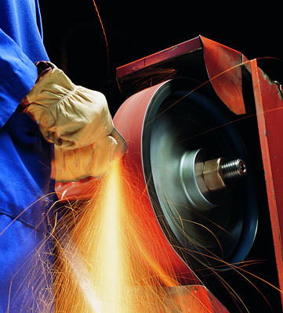
Our Philosophy…
It has been the feeling since our inception in 1985 that if we put together a high-tech repetitive product line, quality manufacturing, great service and representation, that we could find distributors who would want to work together to build a profitable & successful partnership (and have fun doing so).
This has proven to be true and has enabled us to grow at a very aggressive rate.

Slide 3
Why PAI?
We have 10 reasons…
1) Quick access to the best technical assistance available in the marketplace.
2) A complete line of repetitive, technical products (that win tests).
3) A continual flow of new, exciting, and innovative products.
4) Specialized “Production”, “Glass”, and “Cabinet Shop” programs to better your margin.
5) Great standard service with JIT delivery available.
6) Large inventory on Jumbo rolls and finished goods.
7) We only purchase & use world-class equipment.
8) Operators with years of experience, who pride themselves on belt-making.
Innovative and versatile scalloped-edge & splice options.
We supply belts in cloth & polyester to 64” wide & paper to 73” wide with 1 splice.
Particle board belts to 80” wide with 1 splice (widest single splice in the world).
We strongly feel that we can compete at any account… regardless of the competition.
We just need the exposure & an opportunity to test!

Slide 4
Who we are…
PAI is a growing, family-owned company located outside of Punxsutawney, Pennsylvania.
Through our network of Representatives & Distributor partners, we are able to sell throughout the US, Canada, and Mexico.
PAI offers a wide range of products that enables us to sell to many different industries, such as wood, metal, glass, fiberglass, stone, marble, rubber & leather.
Through hard work & conscientious manufacturing, we have developed into a recognized leader in the abrasive manufacturing industry.

Slide 5
Who we are…
We use only world-class equipment throughout our plant. This can include 5 belt making lines (both semi-automated & manual), a fully-automated cut-to-length machine, jumbo & narrow roll slitters, and also disc & sheet presses.
Our operators come with many years of experience. With low turn-over rates, we feel that we have some of the most skillful personnel, who pride themselves on their splices.

Slide 6
Who we are…
We have great partnerships with our overseas suppliers, to which they consider us their manufacturing, marketing, & selling arm here in the US. We are continually working together to improve & develop new products.
Because of our loyalty & history with our long-standing partner suppliers, you can be assured of quality and consistency from run to run. Our suppliers have strict quality standards, which makes our products repetitive! The only time we make a change in our offering is only for upgrades or new products.
Although our suppliers are overseas, we keep a very large inventory in our warehouse (up to 2000 jumbo rolls) to ensure that we meet our standard 3-4 day delivery on make items.

Slide 7
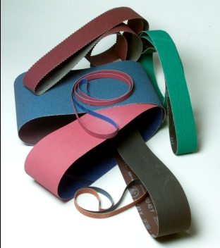
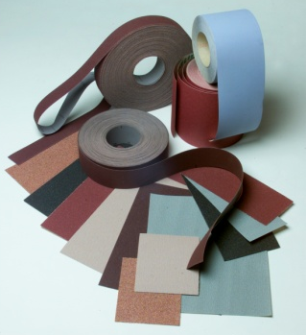
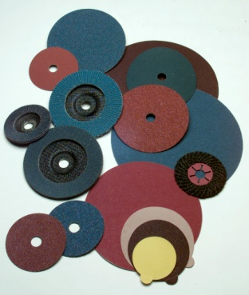
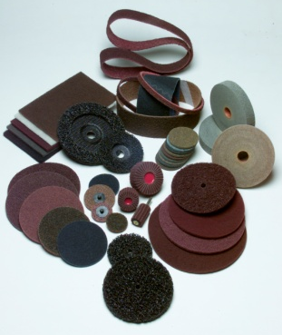
What we offer…
Belts…
* ¼” to 80” wide (1 splice)
* Cloth & Paper
* Alo, A/Z, Sic, Ceramic
Sheets & Rolls…
* 9 x 11 & Cut Sheets
* Shop Rolls & Production Rolls
Discs & Disc Pads…
* Plain, PSA & Prosand (Hook & Loop)
* Resin Fibre & Flapdiscs
* Dust-Free Pearl HG
* Quick-Change, Semi-Flex
Specialties…
* Flapwheels
Surface Conditioning…
* Belts, Discs, Quick-Change, * Hand Pads, Rolls

Slide 8
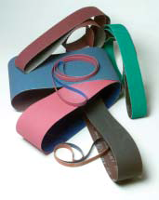
Belts…
Belts are the driving force of our success. They are what we are best at, and what we built our business on. For belt quality, consistency, service & technical knowledge, we are hard to beat.
We offer a wide range of belt products that cover a broad range of industries. From the toughest grinding operations, to the most finicky finishers & polishers, we can cover your needs.
Belt Specs
Sizes – ¼” to 80” with 1 splice.
Splices – Standard Butt, Pro-Loc, Lap, Pro-Lap, Pro-Form.
Other options – Scalloped Edges.
Grains – Aluminum Oxide, Silicon Carbide, Zirconium & Ceramic.
Cloth – From very soft J-Flex to stiff YY-Polyester.
Paper – E and F-wt antistatic.
Film – Durable Film with Velour backing.

Slide 9
Belt Splice & Edge Options…
Splices…
Butt Splice – Our Standard. Well constructed with strength & uniformity.
Pro-Lok Splice – Zig zag configuration. Runs smooth with no hinging on glass, Hetran and some surface conditioning applications.
Lap Splice – Overlapping cloth belt joint that can be skived on top for uniformity.
Pro-Lap Splice – 5/16” lap joint for paper wide belts that is smooth enough to be run bi-directional.
Pro-Form Splice – Tape on face of belt for bump-free, non-marking finish on wood applications.
Edges…
Scalloped-Edge – Zig zag edges allow for smooth metal finishing in intricate contoured areas without gouging.

Slide 10
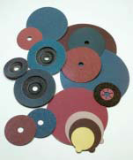
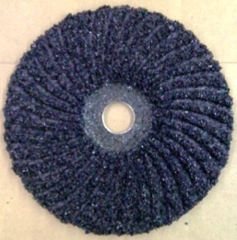
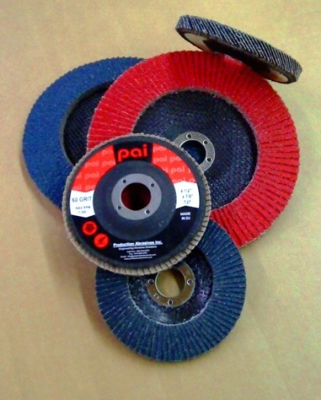
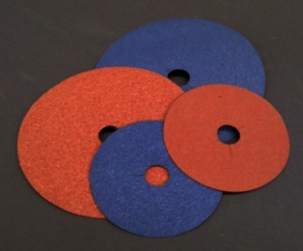
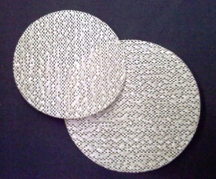
Discs…
Discs are also a big part of what we do at PAI. We offer a complete line of discs ranging from products for rapid removal of slag & heavy welds, to paper & film products for final finishing.
Resin Fibre Discs – Aluminum Oxide, Zirconium & Ceramic.
Flap Discs – Standard & Jumbo, T27 & T29, Zirconium & Ceramic.
Proline Quick-Change Discs – Type R & S, Aluminum Oxide, Zirconium, & Ceramic.
PSA & Prosand (Hook and Loop) Discs - Cloth, Paper & Film.
Semi-Flex Discs – Very aggressive Silicon Carbide grinding products.
Pearl HG Discs – Mesh construction for dust-free sanding & finishing.
Disc Pads – RFD, Quick-Change, PSA and Hook & Loop, Multi-hole for Pearl HG.

Slide 11
Surface Conditioning…
From Scrim-backed items for belts & discs, to Nylon products such as hand pads & rolls, we have a full line. These items are used to clean, blend, deburr & polish.
Surface Conditioning (SCLS, SCXF, SCSB, SCHD)
Belts (1/4” to 40”)
Discs
Quick-Change Discs
Nylon (Clean & Finish, Finish & Deburring, XS (High Strength))
Hand Pads
Discs
Rolls

Slide 12
Sheets & Rolls…
PAI offers a complete line of sheet & roll products for production applications. This can include roughing, finishing and light deburring of wood, metal, glass, fiberglass, and for general maintenance applications.
Sheets
Paper - 9 x 11 and Cut Sheets in Alo , Silicon Carbide, Stearated & Waterproof.
Cloth – 9 x 11 and Cut Sheets in Alo.
Sand screen
Rolls
Paper – Plain & PSA rolls & Re-Fill rolls.
Cloth – Shop Rolls & Production Rolls
Sand screen

Slide 13
What we can do for you…
Quick access to the best abrasive technicians.
Supply quality, repetitive products that win tests.
Provide fast service and JIT deliveries.
Increase you margins.
Provide Protection where you have earned your business.
Knowledgeable, hard-working Sales Reps.
Fast answers from our Customer Service personnel.
Call us today to find out more.

Slide 14
Production Abrasives, Inc. 46 Sheesley Way Hamilton, Pa. 15744 800-784-6572 www.productionabrasives.com info@productionabrasives.com

